Slide 1












TUNISIAN LIGUE 1 ANALYTICS 2024–25
Data-Driven Insights into Players, Teams & Matches
Mahdi Makhloufi

Slide 2


















Project Overview
Tunisian Ligue 1 Analytics
This analysis report aims to provide data-driven insights into the Tunisian Ligue, focusing on team performance, player efficiency, and match trends. The project encompasses data collected from top Tunisian clubs, individual player statistics, and overall league standings, processed through a structured technical workflow from data acquisition to visualization.
Team Performance
Player Efficiency
Match Trends
Analysis of team statistics, offensive and defensive efficiency, and overall standings
Examination of individual player statistics, goal scorers, and assisters
Analysis of disciplinary records, card accumulation, and their impact on team performance
Data-Driven Process
Data Collection
ETL Pipeline
Analysis
Insights
Web scraping from online sources
SSIS & Apache Airflow
SQL & Tableau visualization
Actionable intelligence

Slide 3
















Data Collection & Preparation
Tunisian Ligue 1 Analytics
Web Scraping
Raw Data Storage
Database Setup
Web Scraping
Raw Data Storage
Database Setup
Custom Python scripts developed to scrape essential information from online sources:
Scraped raw data initially stored in Excel files:
PostgreSQL database established with key tables:
ca.py
players
player_stats
ess.py
est.py
teams
team_stats
usmo.py
standings
data/
Folder structure for organized storage
Collected data includes top players, detailed statistics, and league standings
Files stored for easy access and preliminary review
Database designed to store and manage football data efficiently

Slide 4






















ETL Pipeline
Tunisian Ligue 1 Analytics
What is ETL?
ETL Process Flow
Extract, Transform, Load (ETL) is a process that involves extracting data from source systems, transforming it to fit a target schema, and loading it into a destination system.
Extract
Transform
Load
From Excel files
Fit PostgreSQL schema
To database tables
SSIS Implementation
SQL Server Integration Services (SSIS) is used to extract data from Excel files, transform it to fit the predefined schema of the PostgreSQL database, and load it into the respective tables.
DAG Workflow
Apache Airflow Automation
transform_players
Transforms player data
Apache Airflow manages a Directed Acyclic Graph (DAG) that defines the sequence of operations, ensuring data integrity and timely updates.
transform_team_stats
Transforms team statistics
transform_standings
Transforms league standings

Slide 5













Data Analysis Approach
Tunisian Ligue 1 Analytics
Analytical Tools
Focus Areas
Player Performance
SQL Queries
Tableau
Detailed examination of individual statistics including goals, assists, and disciplinary records
Direct data manipulation and insights within PostgreSQL
Advanced visualization and dashboard creation
Team Comparisons
Benchmarking teams based on offensive/defensive efficiency, points per game, and consistency
Analysis Process
League Trends & Standings
Analysis of overall league dynamics, championship contenders, and potential relegation candidates

Slide 6





















Fair Play & Disciplinary Analysis
Tunisian Ligue 1 Analytics
High-Risk Players (Yellow Cards)
Red Card Impact
Impact Analysis
Red cards result in team disadvantages:
Iheb Ben Amor
Ghaith Ben Hassine
Youcef Belaïli
Players miss crucial minutes
10 Yellow
10 Yellow
Jean-Cedrik Gbo
Team often plays with fewer men
10 Yellow
3 Red Cards
Strategic formation changes
These players have high disciplinary risk profiles and could face suspensions
Key Insight:
Red cards directly correlate to team performance decline
Yellow Card Distribution
Disciplinary Impact
Multiple yellows lead to suspension
Red cards affect team morale
Discipline reflects team culture

Slide 7












Offensive Efficiency & Team Strengths
Tunisian Ligue 1 Analytics
Team Efficiency Ratio
Team Efficiency Comparison
Goals Scored / Goals Conceded
This ratio indicates a team's offensive and defensive balance, showing how many goals they score compared to how many they let in.
Best Offensive Team
Espérance Tunis
2.59 goals scored per goal conceded
Offensive Highlights
Defensive Highlights
Espérance Tunis dominates with 2.59 ratio
US Monastir leads with 3.82 goals per conceded
High offensive output with consistent defense
Strong defensive foundation supporting attack
Best Defensive Team
US Monastir
3.82 goals scored per goal conceded

Slide 8







Points & Consistency
Tunisian Ligue 1 Analytics
Points Per Game (2025-26)
Championship Contenders
Espérance's2.20points per game puts them on pace for the league title, 0.13 points ahead of US Monastir.
ESS's consistent2.03points per game shows they're maintaining a strong competitive level.
Importance of Consistency
Teams with fewer losses demonstrate greater consistency and typically perform better in the league.
* Based on total points divided by total matches played
Fewer Losses
More Losses
=
=
Stronger Title Contender
Relegation Risk

Slide 9










Player Analysis
Tunisian Ligue 1 Analytics
Top Scorers
Tactical Dependence Risk
81.25%
Youssef Snanacontributes81.25%ofES Zarzis's goals
Top Assisters
High reliance on key players creates tactical vulnerabilities that can severely impact team performance if those players are injured or suspended.

Slide 10







Team Performance & Stats
Tunisian Ligue 1 Analytics
Goals Scored
Clean Sheets
Wins/Losses
Strategic Insights
Espérance Tunis
US Monastir
Étoile du Sahel
Balance & consistency throughout the season. 19 wins with only 2 losses shows remarkable stability.
Defensive discipline with 20 clean sheets. Despite fewer goals (42), their defensive prowess makes them formidable.
Consistent goal scorer (46 goals) but shows inconsistency with 7 losses compared to Espérance's 2.

Slide 11
















Dashboard & Visual Insights
Tunisian Ligue 1 Analytics
Tableau Dashboard
TUNISIAN LIGUE 1 DASHBOARD
An interactive dashboard providing a dynamic and comprehensive view of Tunisian Ligue 1 analytics.
Top Scorers
Team Stats
Users can explore performance metrics, compare teams, and identify patterns that might not be immediately apparent from raw data.
H. Mastouri
F. Chaouat
Y. Snana
Y. Sasse
Efficiency
Points
Clean Sheets
14 goals
14 goals
13 goals
10 goals
US Monastir
Espérance
US Monastir
3.82
2.20
20
Disciplinary Analysis
Key Highlights
Yellow Cards
Yellow Cards
Yellow Cards
Red Cards
Player & team statistics
I. Ben Amor
G. Ben Hassine
Y. Belaïli
J-C. Gbo
10
10
10
3
League trends
Scoring analysis
Interactive data exploration

Slide 12














Key Takeaways
Tunisian Ligue 1 Analytics
Espérance Tunis's Dominance
Espérance Tunis stands out as a top contender with a potent attack (2.59 goals per game) and remarkable consistency throughout the season. Their balanced performance across offensive and defensive metrics positions them strongly for championship contention.
US Monastir's Defensive Prowess
US Monastir demonstrates exceptional defensive discipline with 20 clean sheets, boasting the best defense in the league. Coupled with an efficient attack (3.82 goals per game), their strategic approach makes them a formidable force.
Summary
Player Dependence Risks
Team efficiency ratios vary significantly
Youssef Snana's contribution of 81.25% of ES Zarzis's goals highlights a tactical vulnerability. Injuries or suspensions to key players could severely impact team performance, creating significant strategic risks.
Points per game correlates with title contention
Discipline impacts team performance
Strategic consistency is a key differentiator
Impact of Fair Play
Disciplinary records directly influence team performance. Players with high card counts (10+ yellows) and Jean-Cedrik Gbo's 3 red cards pose disciplinary risks that can lead to suspensions and put teams at a disadvantage.

Slide 13
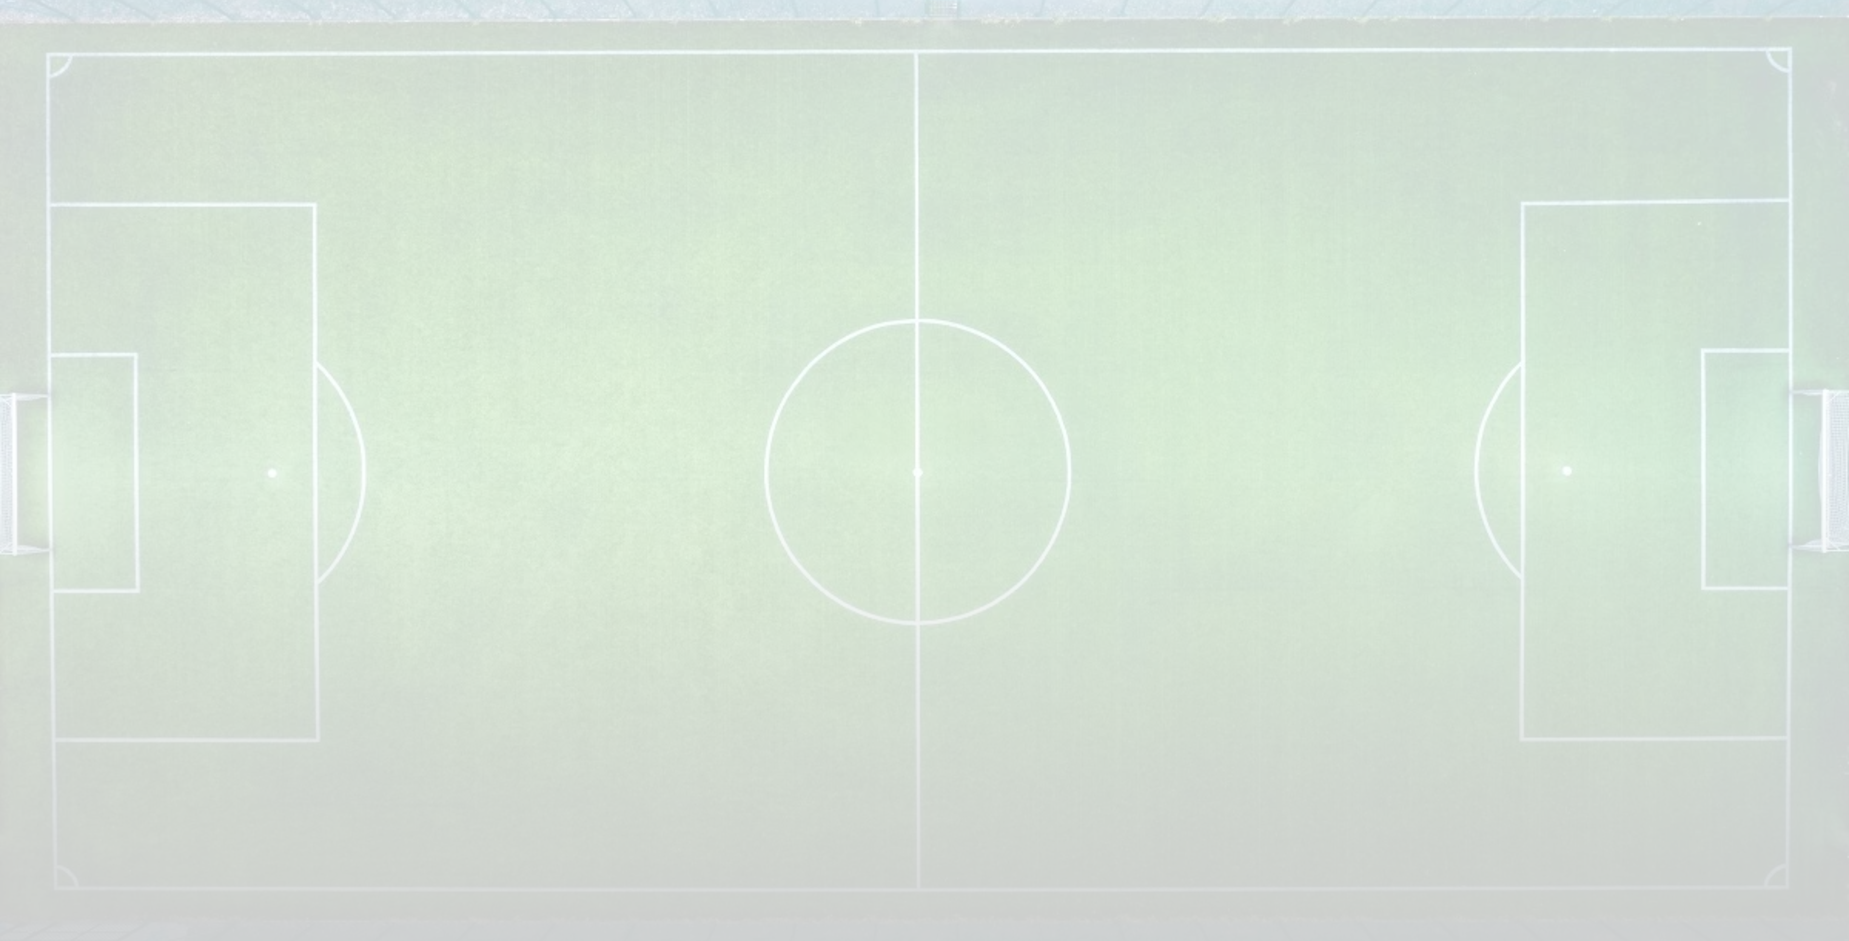






Questions & Discussion
Tunisian Ligue 1 Analytics
Thank you for your attention!
We welcome your questions and insights about the Tunisian Ligue 1 analytics presented today
Team Performance Analysis
Player Contributions
Discuss the strengths and weaknesses of top-performing teams and potential title contenders
Review the most valuable players and their impact on team success
Disciplinary Impact
Strategic Implications
Explore how disciplinary records affect team performance and player development
Consider the broader insights and strategic lessons from the data

